Slide 1
Transformers
Natural Language Processing
(based on revision of John Hewitt Lectures)

Slide 2
Announcement
TA announcements (if any)...

Slide 3
Suggested Readings
Attention Is All You Need (original paper)
The Illustrated Transformer (good visuals; good for understanding but can be confusing when coding)
Transformer (Google AI blog post)
Layer Normalization
Image Transformer (using transformers on images)
Music Transformer: Generating music with long-term structure (using transformers on music)

Slide 4
Transformers

Slide 5
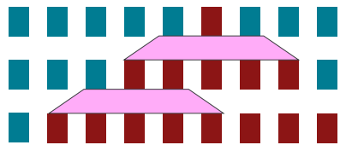
Limitations of RNNs
Ineffective to learn long-distance relationships
Does not allow parallelizability
Inhibits training on very large datasets
Stacked 1D Convolution may help but the window size can never be large enough!

Slide 6
Transformers [Vaswani et al., NeuroIPS 2017]
Output probabilities
Softmax
Originally developed for seq2seq tasks, e.g., MT
Idea: Use attention ONLY (without RNN) will
enable parallelizability hence more efficient
learn long-range dependencies better
provides interpretability
Obstacles:
Loss of sequential information
The decoding side could be a problem if we do everything at the same time, because the input will see the answer (unlike the sequential RNN where each set of input is used to predict the output)
Need to be careful that the whole architecture is always parallelizable at almost every step
Linear
Add & Layer Norm
Add & Layer Norm
Feed Forward
Feed Forward
skip connection
skip connection
Add & Layer Norm
Encoder Layer
Decoder Layer
Multi-Head Cross Attention
K
V
Q
Add & Layer Norm
Add & Layer Norm
Multi-Head Attention
Masked Multi-Head Attention
Q
K
V
Q
K
V
Q
K
V
skip connection
skip connection
skip connection
+
Positional embeddings
(exact same shape as word embeddings)
+
Positional embeddings
(exact same shape as word embeddings)
Input word embeddings
Output word embeddings
Attention Is All You Need, Vaswani et al. 2017, https://arxiv.org/pdf/1706.03762.pdf

Slide 7




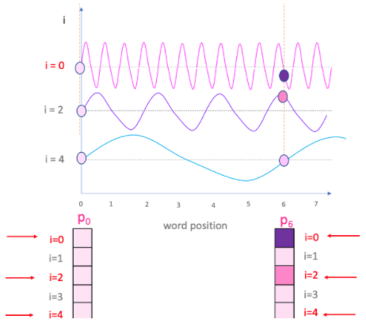

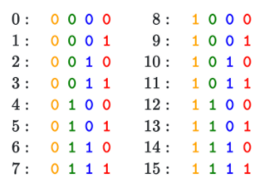


Transformers - Positional Embeddings
Inputting the word embeddings directly to an attention-only module would be silly, since attention does not capture sequential information (i.e., we lose that because we did not use RNN)
How to get this positional embedding?
Use [0, 1]: We can encode each position in the range of 0 and 1. For example, given three words, pos1 has value of 0, pos2 has value of 0.5, and pos3 has value of 1. Anyhow, this method yield inconsistent meaning for different length sentences.
Use numberings: We can encode each position simply by numbering 1, 2, 3 and so on. The problem with this approach is that the model cannot generalize in case that some testing sentences are longer than training sentences.
Use sine/cosine wave: In transformer, the authors have use sine and cosine functions of different frequencies, where pos refers to the position, i refers to the value of the vector indexed at i. Note that the value ranged from [-1, 1].
To address this limitation, we simply create a positional embeddings with exact shape as the word embeddings, and then add them together.
Let be the input word embeddings (one vec per word. We can stack them into a big matrix
where is the number of words and is the embedding size
Intuition behind: You can see sine and cosine as a way to alternate bits just like in binary format like this:
We can create a positional embedding
Pros: Can extend to infinite length
Cons: Not learnable
Now we can simply add them up to create the new input:
Simply let the positional embeddings be learnable parameters by simply passing through some linear layers! Most people use this!
Pros: Learnable
Cons: Can’t extrapolate to indices outside 1,..., T
+
Positional embeddings
(exact same shape as word embeddings)
Input word embeddings

Slide 8

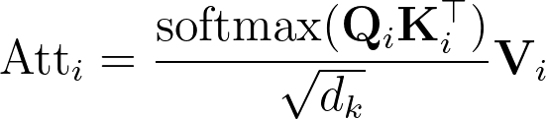
Transformers - Multi-Head Attention
are simply three same copies of X but passing through some transformation, i.e.,
Anyhow, authors of the Transformers paper claimed that it is beneficial to create different versions of Q, K, V so that the model can capture various forms of attention useful for decoding. Thus, let’s say we want 3 versions (a.k.a. heads = ) (in the paper, they use 8 heads), we do like this:
Once we got number of Q, K, V, we calculate the attention using this simple formula:
Multi-Head Attention
Q
K
V
Q
K
V
We then concatenate all these attentions, and multiply just another W matrix to learn any linear transformations required.
+
Positional embeddings
(exact same shape as word embeddings)
Input word embeddings

Slide 9

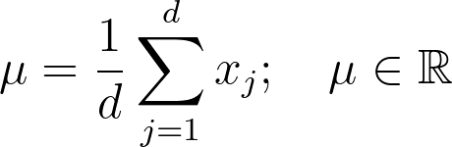



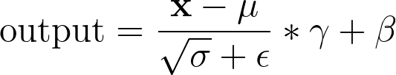
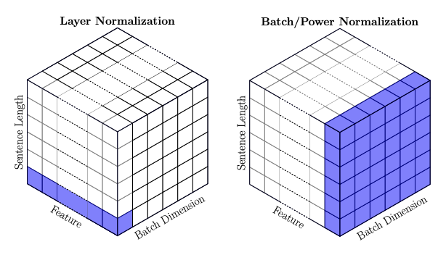
Transformers - Skip connection and layer norm
After we perform the multi-head attention, we add the output with the original input (i.e., X) through skip connection
Skip connection helps with training especially in a very deep network
We then perform layer normalization
Helps model train faster by cutting down on uninformative variation within each layer
Let be an individual (word) vector in the model
Let be the mean
Let be the std
Let and be learned “gain” and “bias” parameters. (optional)
Then layer normalization computes
Difference between batch norm vs. layer norm: batchnorm normalizes across whole batch in each dimension, while layernorm normalizes across feature dimension, for each word independently of other words. Read more: [Source: stackexchange] - Chaky can draw below.
Add & Layer Norm
Multi-Head Attention
Q
K
V
Q
K
V
skip connection
+
Positional embeddings
(exact same shape as word embeddings)
Input word embeddings

Slide 10
Transformers - Encoders
To add some non-linearities, we add a feedforward layer
In the paper, they used two linear layers with a ReLU in between
You can stack as many of this encoder layer as much as you want before sending to the decoder
Add & Layer Norm
Then we again perform skip connections, layer norms
We can repeatedly stack this whole encoder layer as many times we want!
The paper used 6 of these encoder layers (and also 6 decoder layers which we will cover soon)
We are done on the encoder side!
Feed Forward
skip connection
Encoder Layer
Add & Layer Norm
Multi-Head Attention
Q
K
V
Q
K
V
skip connection
+
Positional embeddings
(exact same shape as word embeddings)
Input word embeddings

Slide 11
Transformers - Masked Multi-Head Attention
To use self-attention in decoders, we need to ensure we cannot peek at the future
To enable parallelization, we mask the attention to future words by setting attention scores to -inf
Add & Layer Norm
Feed Forward
skip connection
Decoder Layer
<START>
deep
learning
is
fun
<END>
Encoder Layer
-∞ | -∞ | -∞ | -∞ | -∞ | -∞
 | -∞ | -∞ | -∞ | -∞ | -∞
 |  | -∞ | -∞ | -∞ | -∞
 |  |  | -∞ | -∞ | -∞
 |  |  |  | -∞ | -∞
 |  |  |  |  | -∞
<START>
Add & Layer Norm
Add & Layer Norm
deep
learning
Multi-Head Attention
Masked Multi-Head Attention
Q
K
V
Q
K
V
Q
K
V
is
skip connection
skip connection
skip connection
fun
+
Positional embeddings
(exact same shape as word embeddings)
+
Positional embeddings
(exact same shape as word embeddings)
Input word embeddings
Output word embeddings
<END>

Slide 12
Transformers - Cross attention
Cross attention is just slightly different from normal self-attention, i.e., the queries are from the decoder, while the key and values are from the encoder side
Don’t be confused here - it’s exactly the same as when we first learn attention in L7, where the decoder states are dotted with the encoder states
Add & Layer Norm
Feed Forward
skip connection
Add & Layer Norm
Encoder Layer
Decoder Layer
Multi-Head Cross Attention
K
V
Q
Add & Layer Norm
Add & Layer Norm
Multi-Head Attention
Masked Multi-Head Attention
Q
K
V
Q
K
V
Q
K
V
skip connection
skip connection
skip connection
+
Positional embeddings
(exact same shape as word embeddings)
+
Positional embeddings
(exact same shape as word embeddings)
Input word embeddings
Output word embeddings

Slide 13
Transformers - Decoders
Output probabilities
Softmax
Similar to encoder, you can stack as much decoder layers you want
That’s it!
Some more details:
On both encoder and decoder layers, before inputting to the next layer, they performed a dropout of 0.1
Also, they perform a dropout of 0.1 to the sums of the embeddings and the positional embeddings in both the encoder and decoder stacks
Adam optimizer is used (detailed learning rates and momentum in the paper)
The embedding size is 512
The dimension of the feedforward layer is 2048
Number of epochs trained: 100K
Linear
Add & Layer Norm
Add & Layer Norm
Feed Forward
Feed Forward
skip connection
skip connection
Add & Layer Norm
Encoder Layer
Decoder Layer
Multi-Head Cross Attention
K
V
Q
Add & Layer Norm
Add & Layer Norm
Multi-Head Attention
Masked Multi-Head Attention
Q
K
V
Q
K
V
Q
K
V
skip connection
skip connection
skip connection
+
Positional embeddings
(exact same shape as word embeddings)
+
Positional embeddings
(exact same shape as word embeddings)
Input word embeddings
Output word embeddings

Slide 14
Transformers Results

Slide 15
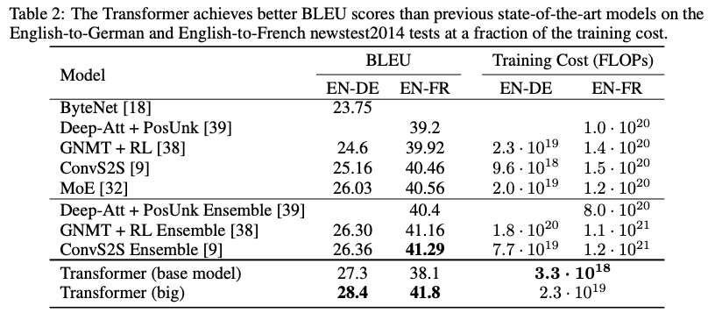
Transformers with MT
Training took 3.5 days on 8 P100 GPUs (used beam search where k = 4). Training cost is a function of training time, number of GPUs used and capacity of each GPU used.

Slide 16
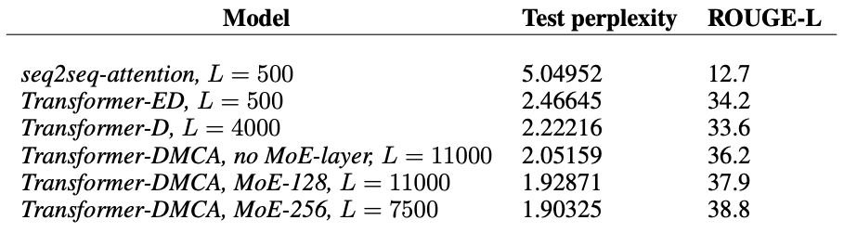
Transformers with text summarization
DMCA is some form of memory compressed attention, where attention is reduced with strided convolution to reduce operations. MoE (mixtures of experts) is proposed by another paper [Shazeer et al. 2017.] which is a layer consists of number of experts, each a simple FF network, and a trainable gating network which selects a combination of the experts (focuses on reducing computational cost). L stands for local attention layer.
Generating wikipedia by summarizing long sequences, Liu et al., 2018 (WikiSum dataset), https://arxiv.org/pdf/1801.10198.pdf

Slide 17
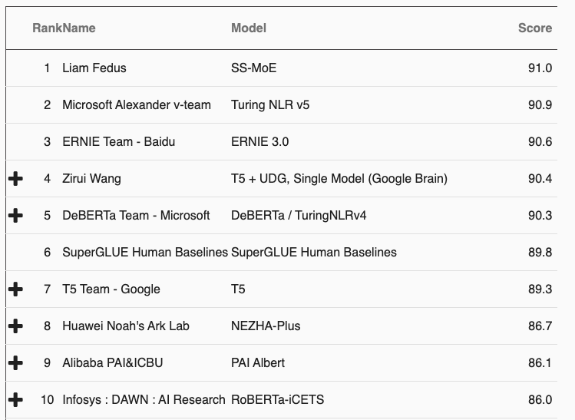
Transformers with SuperGLUE
All of these are based on transformers!
Improvements focus on increasing the number of parameters, reducing training cost, using different positional embeddings, different training scheme (e.g., multi-tasks), different regularization technique. Certainly take a look at these top performers!
The General Language Understanding Evaluation (GLUE) benchmark is a collection of nine sentence - or sentence-pair language understanding tasks. A public leaderboard for tracking performance. The tasks are selected to favor models that share information across tasks using parameter sharing or other transfer learning techniques. The ultimate goal is to develop a generalized and robust NL systems.
https://super.gluebenchmark.com/leaderboard

Slide 18
Transformers Limitations

Slide 19
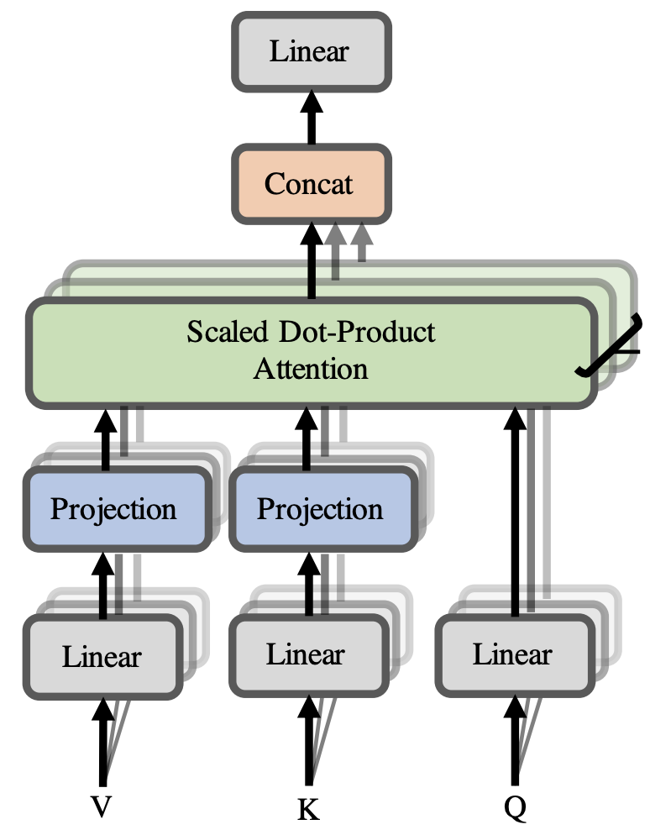
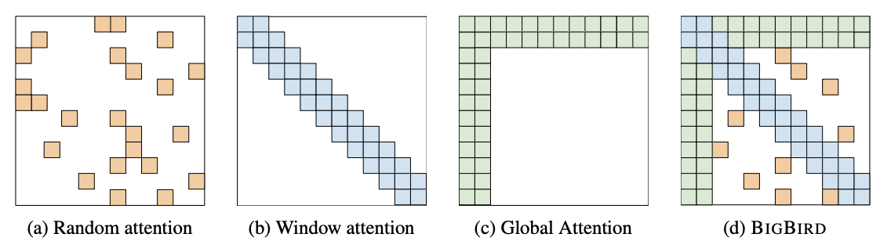
Transformers limitations - costs
Quadratic costs in self-attention
Computing all pairs of interactions means our computation grows quadratically with the sequence length! (Don’t confuse this with the benefits of parallelizability)
In practice, sequence length is set to 512
What if our sequence length is more than 10,000? E.g., summarization?
Compared to recurrent models, it only grew linearly!
Fixes:
Project values and keys to lower dimension (Linformer [Wang et al., 2020])
Replace all-pairs interactions with less aggressive interactions like local windows, random interactions, etc.
Linformer: Self-Attention with Linear Complexity, Wang et al., 2020, https://arxiv.org/pdf/2006.04768.pdf
Big Bird: Transformers for Longer Sequences, Zaheer et al. 2021
https://arxiv.org/pdf/2007.14062.pdf

Slide 20
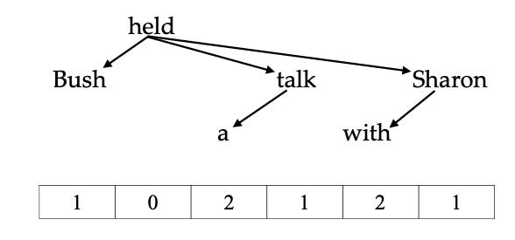
Transformers limitations - positions
Ways to represent position? Some developments:
Relative linear position attention [Shaw et al., 2018]
Each word has NOT only one positional embeddings, but equal to the sequence length, in order to describe the relationship between words
How to learn these relationships -> self attention again!
Improves 1.3 BLEU and 0.3 BLEU on WMT 2014 English to German and English to French translation tasks over absolute position representations
Dependency syntax-based position [Wang et al., 2019]
Use distance of the dependency tree to represent absolute structural position
Improves 0.61 BLEU on average
Anyway, most people simply learn it through some simple linear layter
Self-Attention with Relative Position Representations, Shaw et al., 2018, https://arxiv.org/abs/1803.02155
Self-Attention with Structural Position Representations, Wang, et al., 2019, https://arxiv.org/pdf/1909.00383.pdf

Slide 21
Summary :-)
Output probabilities
Softmax
Linear
Add & Layer Norm
Add & Layer Norm
Feed Forward
Feed Forward
skip connection
skip connection
Add & Layer Norm
Encoder Layer
Decoder Layer
Multi-Head Cross Attention
K
V
Q
Add & Layer Norm
Add & Layer Norm
Multi-Head Attention
Masked Multi-Head Attention
Q
K
V
Q
K
V
Q
K
V
skip connection
skip connection
skip connection
+
Positional embeddings
(exact same shape as word embeddings)
+
Positional embeddings
(exact same shape as word embeddings)
Input word embeddings
Output word embeddings

